Slide 1
CHILDHOOD OBESITY
Dr.Manish Shukla
Dept. of Cardiovascular & Respiratory Physiotherapy
MGM Institute Of Physiotherapy
Chh. Sambhajinagar

Slide 2
INTRODUCTION
Obesity is defined as a condition of excess body fat that creates increased risk for morbidity and/or premature mortality, and the adult BMI thresholds of 25 and 30 kg/m2 for overweight and obesity, respectively. circulation

Slide 3
PREVALENCE
Globally, in 2013 the number of overweight children under the age of five, is estimated to be over 42 million. Close to 31 million of these are living in developing countries.
WHO 2015

Slide 4
Classification
Child v/s adult
BMIs for children and teens compare their heights and weights against growth charts that take age and sex into account. This is called BMI-for-age percentile.
And for adults BMI is calculated

Slide 5
Classification based on growth chart
BMI –for- Age Percentile
Less than 5th percentile | Underweight
5th percentile to less than the 85th percentile | Healthy weight
85th percentile to less than 95th percentile | overweight
95th percentile or greater | obese
BMI ≥120 percent of the 95th percentile values, or a BMI ≥35 kg/m² | Severe obese

Slide 6
Overweight or obese (body mass index [BMI] ≥85th percentile)
22.8 percent of preschool children (2 to 5 years)
34.2 percent of school-aged children (6 to 11 years)

Slide 7
Obese (BMI ≥95th percentile)
8.4 percent of preschool children
17.7 percent of school-aged children
Severe obesity (BMI that is either ≥120 percent of the 95th percentile or ≥35 kg/m² )
2.2 percent of preschool children
8.9 percent of school-aged children

Slide 8
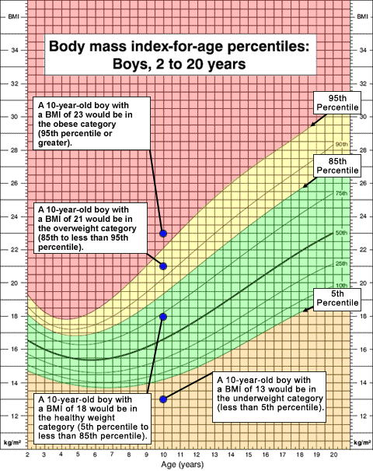

Slide 9
C:\Users\esha\Desktop\cardio\my seminar contents\childhood obesity\cj41l024.pdf
C:\Users\esha\Desktop\cardio\my seminar contents\childhood obesity\cj41l023.pdf

Slide 10
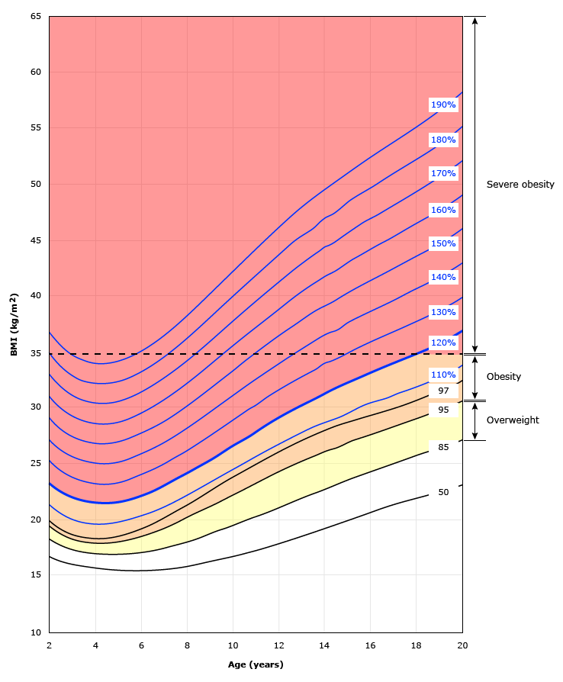
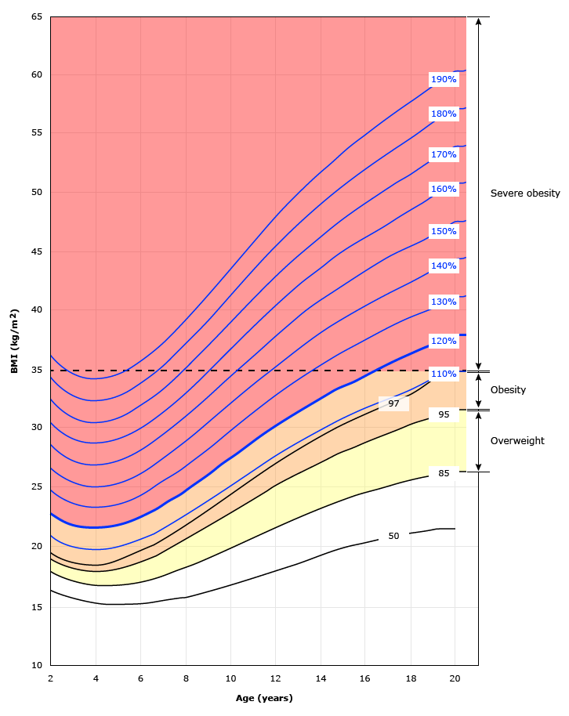

Slide 11
Etiology
Overweight and obesity are caused by an energy imbalance where calories consumed exceed calories expended throughout the day
Environmental factors
Sugar sweetened beverages
Television- video games
Exergames
Sleep
Medication( anti-epileptic , glucocorticoids)

Slide 12
Lack of Physical activity
Overweight parents
Genetics
Endocrine disorders
cortisol excess
hypothyroidism
growth hormone deficiency
pseudohypoparathyroidism

Slide 13
Hypothalamic obesity
Metabolic programming
Gestation

Slide 14
Genetic models of obesity
Agouti gene
Leptin gene
Leptin receptor gene
Other gene

Slide 15
genetics
Genetic: which genes are important determinants of obesity?
Monogenic obesity. Leptin was the first specific gene recognized as important in human body weight control. This adipocyte hormone is involved in a complex circuit of hormones and neurotransmitters to control appetite

Slide 16
Theories of obesity
Potential for obesity
genetic and parental influences
high energy intake
low energy expenditure

Slide 17
1.Genetic and parental influence
Importance of parental obesity in predicting obesity of the offsprings , especially when present during first 10yrs of life.

Slide 18
Another study says that an adult who had been adopted before the age of 1 yr revealed that despite being through up their adoptive parents, their body weight were very similar to those of their biological parents.

Slide 19
Other factors
resting metabolic rate,
energy cost of exercise,
level of habitual physical activity,
tendency to store fat in the abdominal areas,
response to overfeeding,
and relative rate of carbohydrate to lipid oxidation.

Slide 20
Nature of breastfeeding
A systematic review of nine studies has concluded that breastfeeding seems to have a small but consistent protective effect against obesity in children.

Slide 21
2.Energy intake
Humans take in energy in the form of protein, carbohydrate, fat, and alcohol.

Slide 22
3.Energy Expenditure
Humans expend energy through resting metabolic rate (RMR), which is the amount of energy necessary to fuel the body at rest;
- the thermic effect of food, which is the energy cost of absorbing and metabolizing food consumed;
- and the energy expended through physical activity.

Slide 23
Childhood obesity and ANS
ANS (Autonomic Nervous System) is involved in energy metabolism and regulation of cardiovascular system. ANS of obese individuals is chronically altered.
ANS is involved in energy metabolism and regulation of cardiovascular system7,8. Several studies in literature suggest that ANS of obese individuals is chronically altered
The hypothalamus is a regulatory centre of satiety and of the ANS. Therefore, abnormalities in the hypothalamus may cause obesity and autonomic dysfunction13,14. A reduction in parasympathetic activity among obese children has also been reported

Slide 24
Body fat distribution( hormonal)
Gonadal steroids play a major role in the distribution of body fat.
With age, both gonadal steroid and growth hormone secretion decline, which may explain the rise in visceral fat with age in men.
Visceral central adiposity is associated with a greater risk of metabolic and cardiovascular disorders including insulin resistance, type 2 diabetes mellitus, hypertension, and coronary heart disease.

Slide 25
Physiology of overweight
Energy balance
The basic components of energy balance include energy intake, energy expenditure, and energy storage.

Slide 26
When energy intake equals energy expenditure, the body is in energy balance and body energy (generally equivalent to body weight) is stable.
When energy intake exceeds energy expenditure, a state of positive energy balance occurs, and the consequence is an increase in body mass, of which 60% to 80% is usually body fat.

Slide 27
Determinants of energy expenditure
Approx 70% of energy expenditure is utilised for basal or resting metabolic processes.
1. brown adipose tissue and body temperature
2. food
3. activity

Slide 28
1. Brown adipose tissue and body temperature
Brown adipose tissue regulates energy expenditure in newborn infants.
Its activity increases through childhood into adolescence
Located in supraclavicular and neck areas.
Body temperature is regulated by adaptive thermogenesis.

Slide 29
2.Food
The macronutrient composition of food affects energy expenditure, but not fat storage.
Overconsumption of a diet with normal or high compared with low protein increased resting energy expenditure and lean body mass.
The thermal effect of food has an obligatory and a facultative component. A low thermic effect of food is associated with the development of obesity.

Slide 30
3.Activity
The final component of energy expenditure is activity and exercise, known as activity thermogenesis, which includes both exercise and nonexercise activity thermogenesis (NEAT)

Slide 31
Predictors for obesity
Low metabolic rate
Increased carbohydrate oxidation
Insulin resistance
Low sympathetic activity

Slide 32
Adiposity and obesity
Over-weight children are atleast 2.4 times more likely to have
elevated total cholestrol, triglycerides,
low high-density lipoprotein cholestrol,
low fasting insulin,
and elevated blood pressure.

Slide 33
Blood lipids and obesity
Atherosclerotic process begin in early childhood and is influenced by hyperlipidemia.

Slide 34
Parameters to be checked
Lipid profile
Lipoprotein
Apo-lipoprotein
Blood glucose
Insulin level
FFA levels
Hepatic transaminase

Slide 35
Triglycerides HDL and fasting hyperglycemic and hypertension do not seem to have association with metabolic syndrome in children as seen in adult( childhood obesity www.ncbi.nlm.nih.gov/pmc/articles/PM3063535/

Slide 36
Normative data
Lipid fraction | Optimal level (mg/dL) | Risk level (mg/dL)
HDL-C | >60 | <35
TC | <170 | >200
Non – HDL | <130 | >190
LDL | <114 | >130

Slide 37
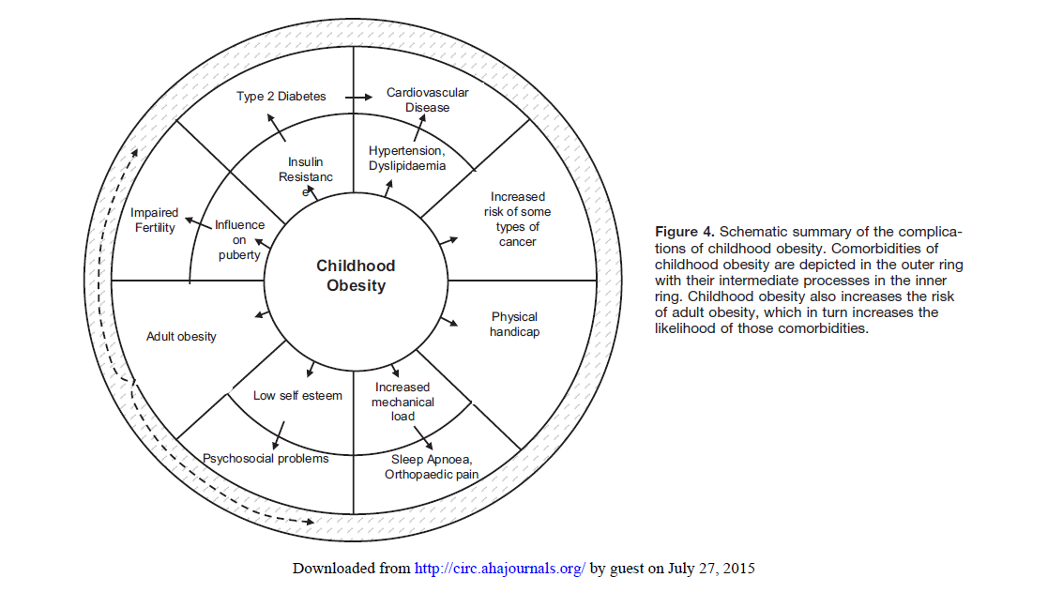
COMPLICATIONS

Slide 38
Evaluation
History – age of onset of overweight
Eating and exercise habits
Dietary history
family history
pyschosocial history

Slide 39
A focused and problem-oriented history assessment in the
obese child has three major aims:
i) to rule out an underlying
organic disorder,
ii) to identify the presence of co-morbidities,
and iii) to assess the risk of developing co-morbidities.
In the vast majority of children, the cause of overweight or
obesity is a predisposing genetic background (obese parents or
other family members) and the impact of the obesogenic environment,
leading to sedentary behaviour and increased consumption
of calorie-dense food.

Slide 40
Physical examination
BMI
Search for stigmata of syndromes associated with obesity –developmental delay dysmorphism, hypogonadism, and purple abdominal striae
Measure blood pressure
Musculoskeltal system

Slide 41
Complete biochemistry including liver function and a fasting lipid profile.
Complete blood count
Evaluate glucose metabolism

Slide 42
Nutritional assessment
Nutritional assessments should include an evaluation of current intake (most importantly fruit and vegetables, sweetened beverages, fast food, portion sizes) as well as meal and snack patterns (e.g. frequency and quality of meals such as breakfast).

Slide 43
Identify timing and locations of meals .
2. Quantify sweetened beverage consumption .
3. Assess positive components of the diet, such as fruit and vegetables, fish, and grains.
4. Assess portion sizes
5. Ask what the child eats during school time.

Slide 44
Physical activity assessment
Assess hours per day of sedentary activities – such as television watching and computer time.
Ask about any additional activity and participation in organised sports outside of the school system.
3. Ask how the child gets to school – walking, cycling, car, public transport.
4. Assess family activities – do the parents and siblings engage in any physical activity?

Slide 45
Obesity is commonly associated with nonalcoholic fatty liver disease, elevated alanine transaminase (ALT) levels as well as other liver function abnormalities. The typical dyslipidaemia seen in obese children includes elevated triglycerides and reduced HDL(high-density lipoprotein)-cholesterol. The presence of this lipid profile is highly suggestive of significant insulin resistance

Slide 46
Activity history will include
identification of barriers to walking or riding a bike to school
evaluation of time spent in play
evaluation of school recess and physical education
assessment of after school and weekend activities
assessment of screen time

Slide 47
Examination
General appearance
Blood pressure
Stature
Musculoskeletal
developmental

Slide 48
Lab investigations
Routine screening for type 2 diabetes mellitus
Dyslipidemia
Hypertension
Fatty liver disease
Vitamin D deficiency

Slide 49
Exercise testing
body composition
hydrostatic weighing
skinfold measurement
BMI
bioelectrical impedence
dual energy X –ray absorptiometry

Slide 50
Risk of obesity | Sum of skin folds(mm) |  | Body fat (%)
 | Boys | Girls | Boys | Girls
Optimal | 21-25 | 16-34 | 10-20 | 15-27
Moderate risk | 25-33 | 34-42 | 20-25 | 17-32
High | >33 | >42 | >25 | >32

Slide 51
Skin fold
Triceps and calf skinfolds
%fat= 0.735* SF +1.0 males, all ages
%fat= 0.610*SF+5.0 females, all ages
Triceps and subscapularis skinfolds
%fat = 0.783*SF

Slide 52
Aerobic capacity
Maximal oxygen uptake- it is the highest volume of oxygen that can be consumed during an exercise bout per unit of time.
calculated on basis of
treadmill ergometry
cycle ergometry
field test of aerobic capacity

Slide 53
Anaerobic capacity
wingate anaerobic cycle power
field test of anaerobic capacity
standing vertical jump

Slide 54
Muscle strength and endurance
for this as such no specific factors have been established with certainty in children because the developmental group lacks pre-requisite hormone and also stress imposed by this training was not safe.
calculated on basis of 1RM

Slide 55
Contraindication to exercise
Acute inflammatory cardiac disease(pericarditis,myocarditis)
Uncontrolled congestive heart failure
Acute myocardial infarction
Acute pulmonary disease
Severe systemic hypertension
Acute renal disease
Acute hepatitis
Drug overdose affecting cardiorespiratory response

Slide 56
Termination criteria
Excessive increase in systolic blood pressure over 240mmHg or diastolic pressure over 120mmHg
Progressive decrease in systolic blood pressure
Pallor or clamminess of the skin
Pain, headache, dyspnea, or nausea.

Slide 57
Flexibility
trunk extension test
traditional sit and reach test flexibility test
back saver sit and reach test.

Slide 58
Exercise prescription
Cardiovascular training
Muscular strength and endurance
Flexibility all on FITT principle

Slide 59
 | Basic health related fitness | Intermediate health related fitness | Atheletic health related fitness
frequency | 3 times per week | 3-5 times per week | 5-6 times per week
intensity | 50-60% HR max | 60-75% HR max | 65-90% HR max
Time | 30 min total,accumulated | 40-60 min total, accumulated | 60-120 min , accumulated
Type | Walking jogging dancing games | Walking jogging fitness based games | Training programe, aerobics, community sports program

Slide 60
 | basic | intermediate | athletics
Frequency | 2-3 times per week , minimum 1 day rest between traing session | 3-4 times per day alternate upper and lower body segments | 4-5 times per week, specific to sports participation
Intensity | Very light <40% of projected maximal effort | Light to moderate, 50-70% | Specific load required for sports participation
Time | 1-2 set of 6-12 reps | 1-3 set of 6-15 reps | 3-5 sets of 5-20 reps
Type | Body weight, single to multijoint activities | Resistance exercise | Advanced sports specific

Slide 61
 | basic | intermediate | athletics
Frequency | Before and after each activity or exercise session( mimimun 3 times per week) | Before and after each exercise session(daily) | Before and after each exercise session
Intensity | Mild tension | Mild tension | Mild tension, sports specific
Time | 10-15 sec two times per stretch | 10-15 times three times per stretch | Dependent on static dynamic
Type | Static major group muscle | Static major grp ms including dynamic strtching | Dynamic or ballistic

Slide 62
Health risk are greater for those who have most of the fat in upper body especially in trunk and abdominal areas- android obesity
Gynoid obesity deposition of body fat in hip and thighs
Measured by waist hip ratio

Slide 63
Fat cells in abdominal areas are more active (release and taking up of fat molecule) than those in gluteal and femoral areas . When the supply of abdominal fat is too great , the cells release their fat into the blood vessels that go into the liver; the fat that travels to the liver is linked to negative health consequence.

Slide 64
Management
The optimum amount of physical activity for
young children should accumulate at least 30 minutes of moderate intensity activity on most and preferably all days of the week.

Slide 65
To increase childs activity level
Limit TV and recreational computer time to no more than 2 hrs a day
Emphazise activity and not exercise
Find activities which the child likes

Slide 66
Healthy eating
Choose fruits and vegetables
Limit sweetened beverages
Limit fast food
Serve appropriate portion sizes
Sit down together for family meals

Slide 67
Role of school
Adress physical activity
Design school health coordinator and maintain active school health council
Assess school health policies
Increase opportunities for students to engage in physical activity
Implement a quality school meal program

